Slide 1

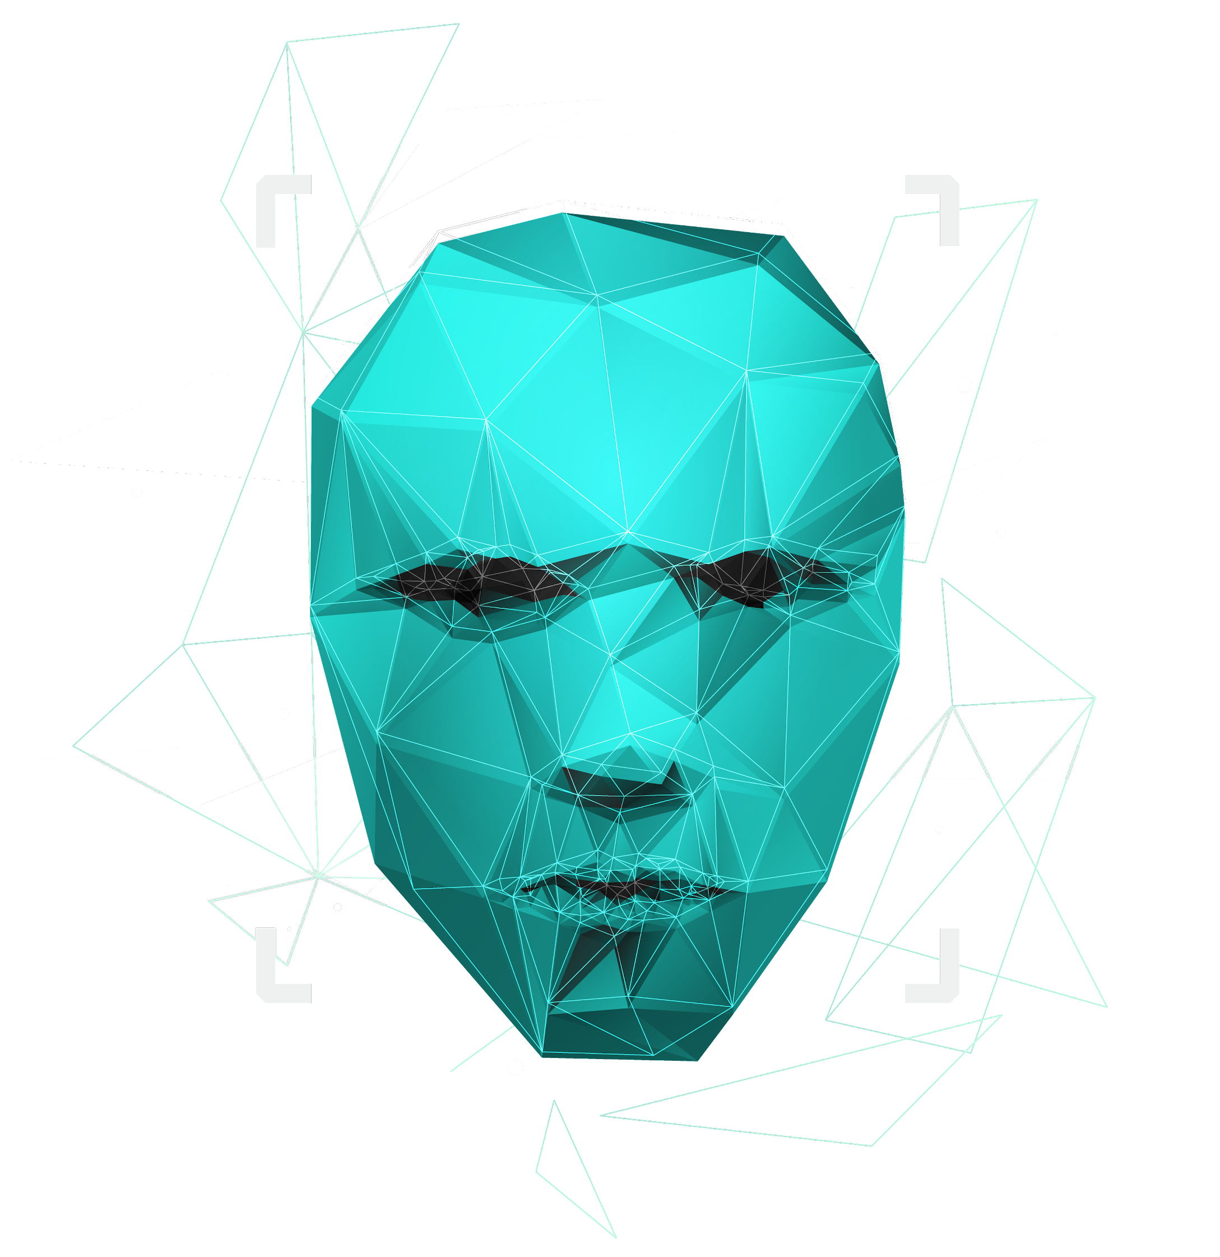
Attendance System Using Facial Recognition
Presented by :
Lakim Dahal (018-315)
Shankar Dangaura (018-334)
Sunil Mandal (018-338)

Slide 2
Introduction
“Attendance System Using Facial Recognition” is an web based application.
This app will be using face recognition technique for identifying, verifying and distinguishing employees.
It will recognize a person from a distance.
This system will involve registration of employees by taking their images and set for Attendance.
Slide 1

Slide 3
PROBLEM STATEMENT
Manual roll calling or signature against respective name is traditional form
Previous models are relatively slower in object identifying
Deep learning has been highly explored for computer vision applications.
Slide 2

Slide 4
OBJECTIVES
To maintain a record staff attendance.
To identify and verify employees precisely
To eliminate manual marking of attendance
To make employees more diligent about attending office.
Slide 3

Slide 5
Scope
Hardware: Cameras, scanners, and servers for capturing and processing face recognition data.
Software: Face recognition software for identification and verification. Additional software for attendance data management and analysis.
Maintenance: Maintenance to ensure the proper functioning and accuracy.
Data Management: Secure management and storage of the generated attendance data.
Slide 4

Slide 6
Application
In schools to track student and staff attendance, monitor attendance rates.
In conferences to ensure authorized access, collect data for analysis.
In government agencies to track employee and contractor attendance, ensure authorized access.
In corporate offices to streamline attendance tracking, improve efficiency.
Slide 5

Slide 7

System design and tools used
Slide 6

Slide 8
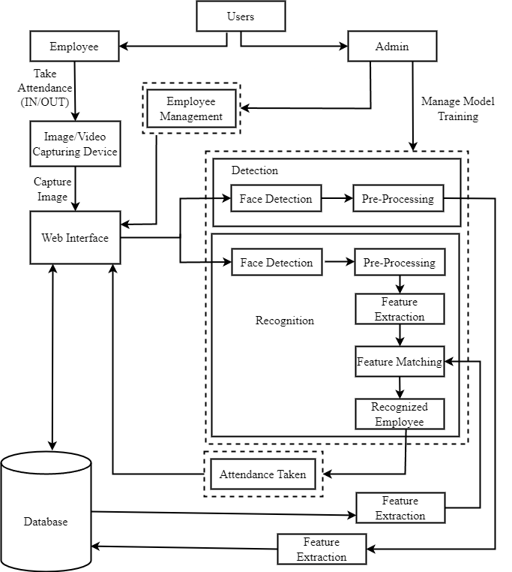
System Architecture
Slide 7

Slide 9



User Model
Employee
Admin
Login, generate own attendance report, take attendance (in/ out), change password
Login, Register new employees to the system, trains dataset, View attendance report of all employees
Slide 8

Slide 10




Experimental Tools And Setup
Slide 9

Slide 11
Implementation and discussion
Slide 10

Slide 12
Task Implemented
Front-end:
Signing up for new users.
Registering new employees.
Training data model.
Back-end:
Creating new employees.
Logging in with authentication.
Employee detection and recognition.
Updating attendance records.
Slide 11

Slide 13
Output Obtained
Admin can register new employees and train the datasets
Registered employee and admin can login via login UI.
Employees can take attendance (IN/OUT).
Report printing based on date and employee name.
Slide 12

Slide 14
Limitations and Future Enhancements
Limitations
The employee's time shifts
Not able to distinguish live or stationary object.
Future enhancements
Improve algorithm accuracy for image recognition.
Implement leave management system within the attendance system.
Develop a desktop application for added accessibility.
Explore hardware implementation using Raspberry Pi or Arduino boards.
Slide 13

Slide 15
CONCLUSION
In conclusion, our project successfully developed an attendance system using facial recognition technology. By implementing the Viola-Jones algorithm and OpenCV methods, we created an accurate and efficient system that recognizes employees based on trained datasets.
We appreciate the collaborative effort of our team members and envision future enhancements to optimize scalability and performance.
Slide 14

Slide 16
THANK YOU!
ANY QUESTIONS ?

